Slide 1

Pokok Bahasan 13:
SIFAT-SIFAT TRANSFORMASI LAPLACE

Slide 2
Sub Pokok Bahasan
1
Linear
2
Translasi Pertama
3
Translasi Kedua
4
Transformasi Derivatif
5
Perkalian Suatu Fungsi oleh $t^{n}$
6
Transformasi Integral
7
Transformasi dari Fungsi Periodik

Slide 3
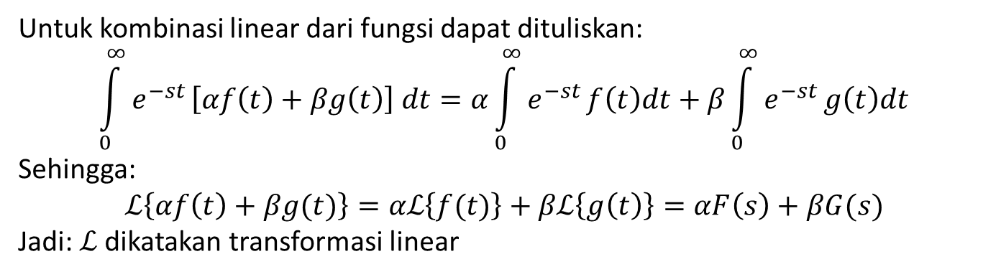
1
Linear
Untuk kombinasi linear dari fungsi dapat dituliskan:
$$\int_{0}^{∞}{e^{−st}}\left[αf\left(t\right)+βg\left(t\right)\right] dt=α\int_{0}^{∞}{e^{−st}}f\left(t\right)dt+β\int_{0}^{∞}{e^{−st}}g\left(t\right)dt$$
Sehingga:
$$ℒ\left\{αf\left(t\right)+βg(t)\right\}=αℒ\left\{f(t)\right\}+βℒ\left\{g\left(t\right)\right\}=αF\left(s\right)+βG(s)$$
Jadi:$ℒ$ dikatakan transformasi linear

Slide 4
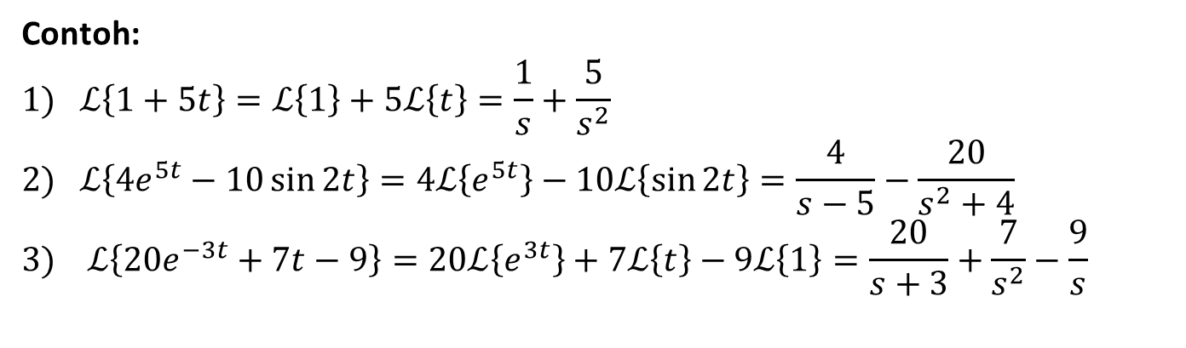
1
Linear
Contoh:
$$1) ℒ\left\{1+5t\right\}=ℒ\left\{1\right\}+5ℒ\left\{t\right\}=\frac{1}{s}+\frac{5}{s^{2}}$$
$$2) ℒ\left\{4e^{5t}−10\sin{2t}\right\}=4ℒ\left\{e^{5t}\right\}−10ℒ\left\{\sin{2t}\right\}=\frac{4}{s−5}−\frac{20}{s^{2}+4}$$
$$3) ℒ\left\{20e^{−3t}+7t−9\right\}=20ℒ\left\{e^{3t}\right\}+7ℒ\left\{t\right\}−9ℒ\left\{1\right\}=\frac{20}{s+3}+\frac{7}{s^{2}}−\frac{9}{s}$$

Slide 5
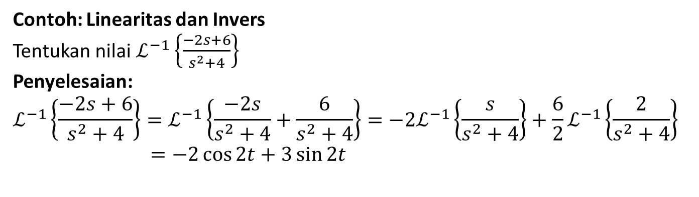
1
Linear
Contoh: Linearitas dan Invers
Tentukan nilai$ℒ^{−1}\left\{\frac{−2s+6}{s^{2}+4}\right\}$
Penyelesaian:
$$ℒ^{−1}\left\{\frac{−2s+6}{s^{2}+4}\right\}=ℒ^{−1}\left\{\frac{−2s}{s^{2}+4}+\frac{6}{s^{2}+4}\right\}=−2ℒ^{−1}\left\{\frac{s}{s^{2}+4}\right\}+\frac{6}{2}ℒ^{−1}\left\{\frac{2}{s^{2}+4}\right\}$$
$=−2\cos{2t}+3\sin{2t}$

Slide 6
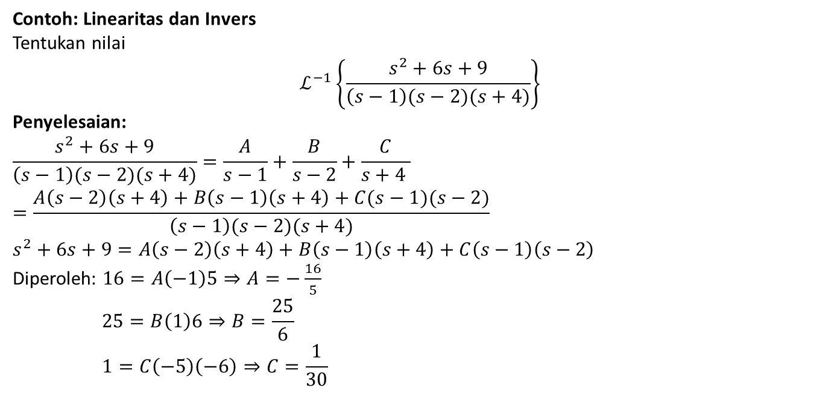
1
Linear
Contoh: Linearitas dan Invers
Tentukan nilai
$$ℒ^{−1}\left\{\frac{s^{2}+6s+9}{\left(s−1\right)(s−2)(s+4)}\right\}$$
Penyelesaian:
$$\frac{s^{2}+6s+9}{\left(s−1\right)(s−2)(s+4)}=\frac{A}{s−1}+\frac{B}{s−2}+\frac{C}{s+4 }$$
$$=\frac{A\left(s−2\right)\left(s+4\right)+B\left(s−1\right)\left(s+4\right)+C(s−1)(s−2)}{\left(s−1\right)(s−2)(s+4)}$$
$$s^{2}+6s+9=A\left(s−2\right)\left(s+4\right)+B\left(s−1\right)\left(s+4\right)+C\left(s−1\right)\left(s−2\right)$$
Diperoleh: $16=A\left(−1\right)5⇒A=−\frac{16}{5}$
$$25=B\left(1\right)6⇒B=\frac{25}{6}$$
$$1=C\left(−5\right)\left(−6\right)⇒C=\frac{1}{30}$$

Slide 7
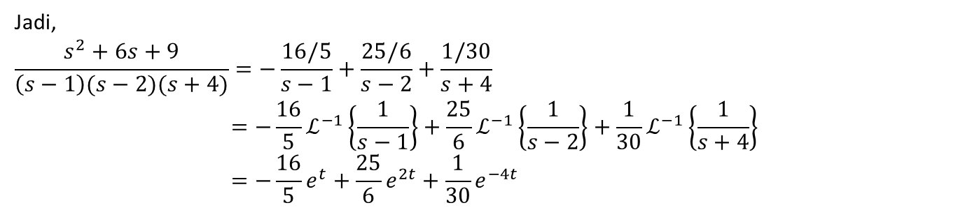
1
Linear
Jadi,
$$\frac{s^{2}+6s+9}{\left(s−1\right)(s−2)(s+4)}=−\frac{16/5}{s−1}+\frac{25/6}{s−2}+\frac{1/30}{s+4}$$
$$=−\frac{16}{5}ℒ^{−1}\left\{\frac{1}{s−1}\right\}+\frac{25}{6}ℒ^{−1}\left\{\frac{1}{s−2}\right\}+\frac{1}{30}ℒ^{−1}\left\{\frac{1}{s+4}\right\}$$
$$=−\frac{16}{5}e^{t}+\frac{25}{6}e^{2t}+\frac{1}{30}e^{−4t}$$

Slide 8
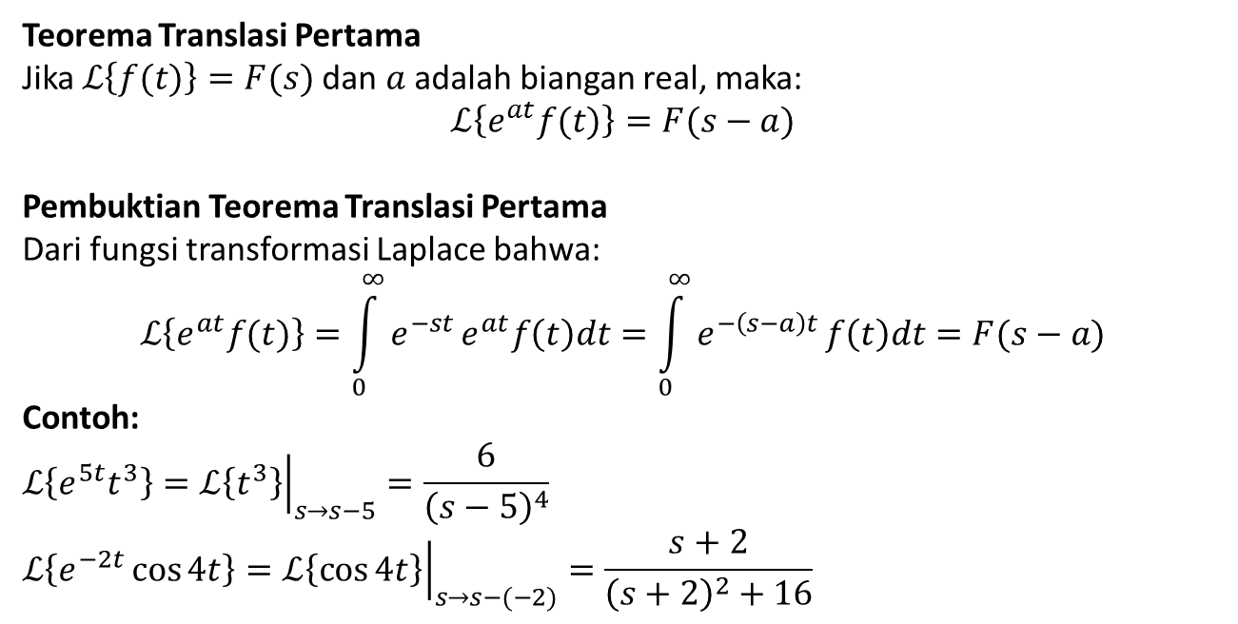
2
Translasi Pertama
Teorema Translasi Pertama
Jika$ℒ\left\{f(t)\right\}=F(s)$ dan $a$ adalah biangan real, maka:
$$ℒ\left\{e^{at}f(t)\right\}=F(s−a)$$
Pembuktian Teorema Translasi Pertama
Dari fungsi transformasi Laplace bahwa:
$$ℒ\left\{e^{at}f(t)\right\}=\int_{0}^{∞}{e^{−st}}e^{at}f\left(t\right)dt=\int_{0}^{∞}{e^{−\left(s−a\right)t}}f\left(t\right)dt=F(s−a)$$
Contoh:
$$ℒ\left\{e^{5t}t^{3}\right\}={\left.ℒ\left\{t^{3}\right\}\right|}_{s→s−5}^{ }=\frac{6}{{\left(s−5\right)}^{4}}$$
$$ℒ\left\{e^{−2t}\cos{4t}\right\}={\left.ℒ\left\{\cos{4t}\right\}\right|}_{s→s−(−2)}^{ }=\frac{s+2}{{\left(s+2\right)}^{2}+16}$$

Slide 9
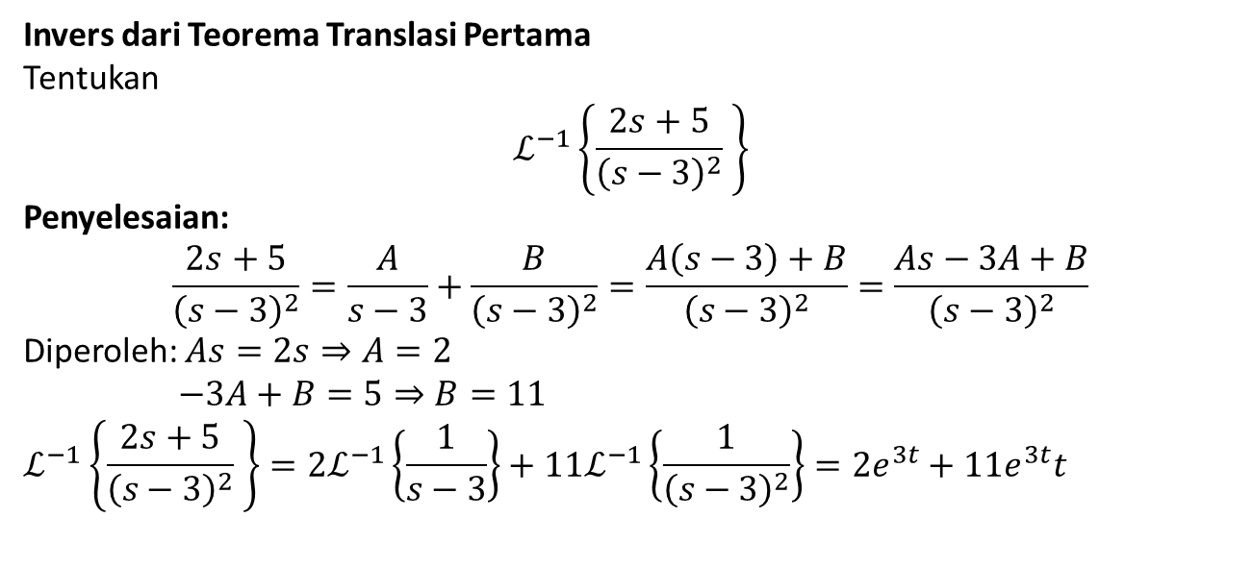
2
Translasi Pertama
Invers dari Teorema Translasi Pertama
Tentukan
$$ℒ^{−1}\left\{\frac{2s+5}{{\left(s−3\right)}^{2}} \right\}$$
Penyelesaian:
$$\frac{2s+5}{{\left(s−3\right)}^{2}}=\frac{A}{s−3}+\frac{B}{{\left(s−3\right)}^{2}}=\frac{A\left(s−3\right)+B}{{\left(s−3\right)}^{2}}=\frac{As−3A+B}{{\left(s−3\right)}^{2}}$$
Diperoleh: $As=2s⇒A=2$
$$−3A+B=5⇒B=11$$
$$ℒ^{−1}\left\{\frac{2s+5}{{\left(s−3\right)}^{2}} \right\}=2ℒ^{−1}\left\{\frac{1}{s−3}\right\}+11ℒ^{−1}\left\{\frac{1}{{\left(s−3\right)}^{2}}\right\}=2e^{3t}+11e^{3t}t$$

Slide 10
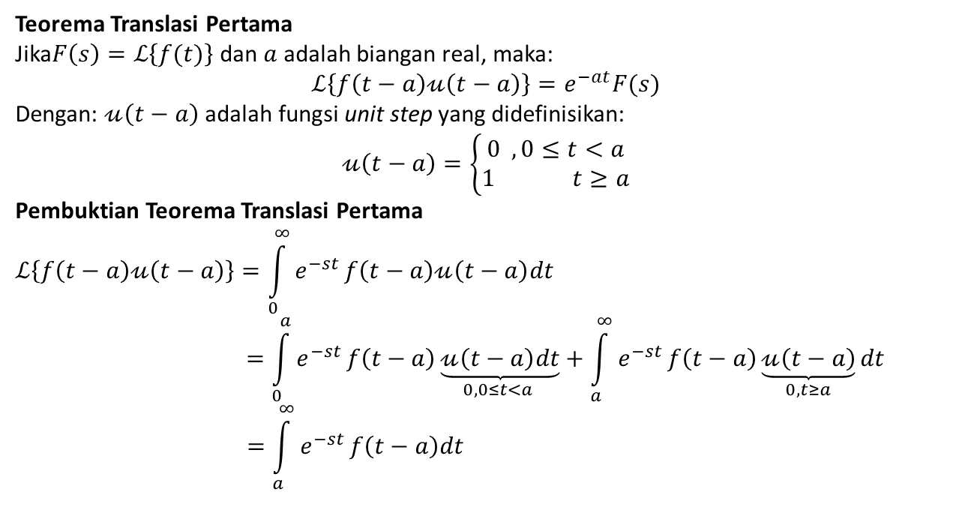
3
Translasi Kedua
Teorema Translasi Pertama
Jika$F\left(s\right)=ℒ\left\{f(t)\right\}$dan $a$ adalah biangan real, maka:
$$ℒ\left\{f\left(t−a\right)𝓊\left(t−a\right)\right\}=e^{−at}F(s)$$
Dengan: $𝓊\left(t−a\right)$ adalah fungsi unit step yang didefinisikan:
$$𝓊\left(t−a\right)=\left\{\begin{matrix}0 , 0≤t<a \\ 1 t≥a\end{matrix}\right.$$
Pembuktian Teorema Translasi Pertama
$$ℒ\left\{f\left(t−a\right)𝓊\left(t−a\right)\right\}=\int_{0}^{∞}{e^{−st}}f\left(t−a\right)𝓊\left(t−a\right)dt$$
$$=\int_{0}^{a}{e^{−st}}f\left(t−a\right)\underset{0, 0≤t<a }{\underbrace{𝓊\left(t−a\right)dt}}+\int_{a}^{∞}{e^{−st}}f\left(t−a\right)\underset{0, t≥a}{\underbrace{𝓊\left(t−a\right)}}dt$$
$$=\int_{a}^{∞}{e^{−st}}f\left(t−a\right)dt$$

Slide 11
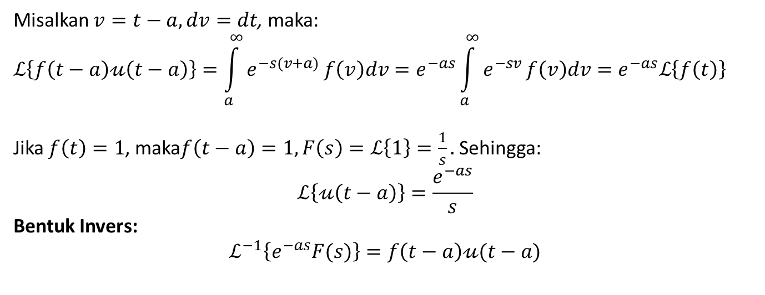
3
Translasi Kedua
Misalkan $v=t−a, dv=dt$, maka:
$$ℒ\left\{f\left(t−a\right)𝓊\left(t−a\right)\right\}=\int_{a}^{∞}{e^{−s(v+a)}}f\left(v\right)dv=e^{−as}\int_{a}^{∞}{e^{−sv}}f\left(v\right)dv=e^{−as}ℒ\left\{f\left(t\right)\right\}$$
Jika $f\left(t\right)=1$, maka$f\left(t−a\right)=1, F\left(s\right)=ℒ\left\{1\right\}=\frac{1}{s}.$Sehingga:
$$ℒ\left\{𝓊\left(t−a\right)\right\}=\frac{e^{−as}}{s}$$
Bentuk Invers:
$$ℒ^{−1}\left\{e^{−as}F(s)\right\}=f\left(t−a\right)𝓊(t−a)$$

Slide 12
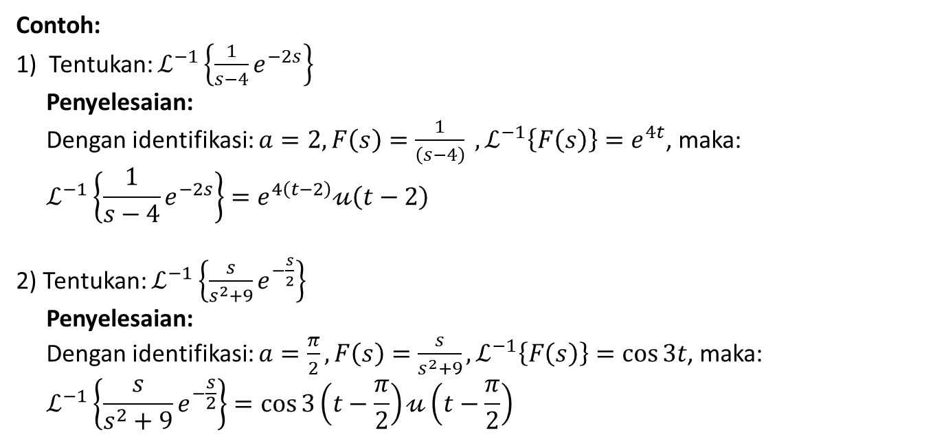
3
Translasi Kedua
Contoh:
1) Tentukan: $ℒ^{−1}\left\{\frac{1}{s−4}e^{−2s}\right\}$
Penyelesaian:
Dengan identifikasi: $a=2, F\left(s\right)=\frac{1}{\left(s−4\right)} ,ℒ^{−1}\left\{F\left(s\right)\right\}=e^{4t}$, maka:
$$ℒ^{−1}\left\{\frac{1}{s−4}e^{−2s}\right\}=e^{4\left(t−2\right)}𝓊\left(t−2\right)$$
2) Tentukan: $ℒ^{−1}\left\{\frac{s}{s^{2}+9}e^{−\frac{s}{2}}\right\}$
Penyelesaian:
Dengan identifikasi: $a=\frac{π}{2}, F\left(s\right)=\frac{s}{s^{2}+9},ℒ^{−1}\left\{F\left(s\right)\right\}=\cos{3t}$, maka:
$$ℒ^{−1}\left\{\frac{s}{s^{2}+9}e^{−\frac{s}{2}}\right\}=\cos{3\left(t−\frac{π}{2}\right)}𝓊\left(t−\frac{π}{2}\right)$$

Slide 13
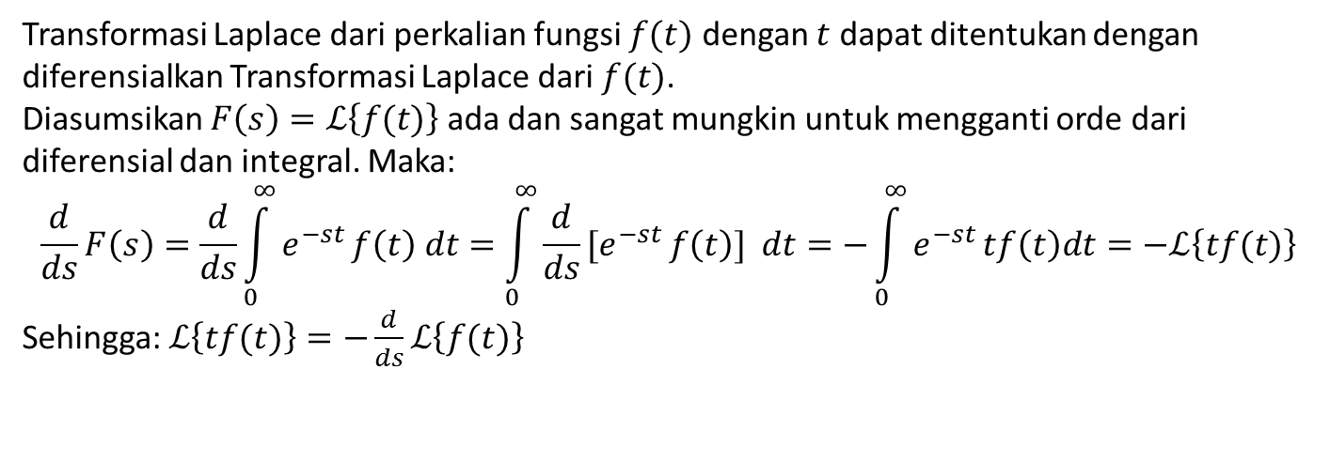
4
Transformasi Derivatif
Transformasi Laplace dari perkalian fungsi $f(t)$ dengan $t$ dapat ditentukan dengan
diferensialkan Transformasi Laplace dari $f(t)$.
Diasumsikan $F\left(s\right)=ℒ\left\{f(t)\right\}$ada dan sangat mungkin untuk mengganti orde dari
diferensial dan integral. Maka:
$$\frac{d}{ds}F\left(s\right)=\frac{d}{ds}\int_{0}^{∞}{e^{−st}}f\left(t\right) dt=\int_{0}^{∞}{\frac{d}{ds}{[e}^{−st}}f\left(t\right)] dt=−\int_{0}^{∞}{e^{−st}}tf\left(t\right)dt=−ℒ\left\{tf(t)\right\}$$
Sehingga: $ℒ\left\{tf(t)\right\}=−\frac{d}{ds}ℒ\left\{f(t)\right\}$

Slide 14
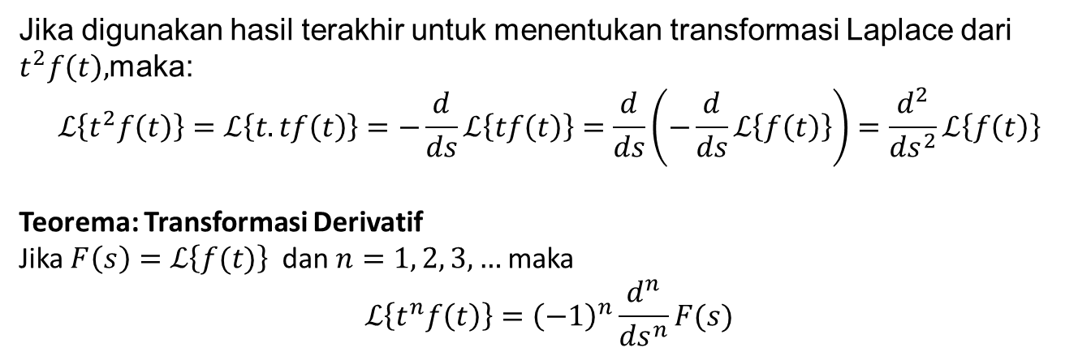

5
Perkalian Suatu Fungsi oleh $t^{n}$
Jika digunakan hasil terakhir untuk menentukan transformasi Laplace dari
$t^{2}f\left(t\right),$maka:
$$ℒ\left\{t^{2}f\left(t\right)\right\}=ℒ\left\{t.tf\left(t\right)\right\}=−\frac{d}{ds}ℒ\left\{tf\left(t\right)\right\}=\frac{d}{ds}\left(−\frac{d}{ds}ℒ\left\{f\left(t\right)\right\}\right)=\frac{d^{2}}{ds^{2}}ℒ\left\{f\left(t\right)\right\}$$
Teorema: Transformasi Derivatif
Jika $F\left(s\right)=ℒ\left\{f(t)\right\}$ dan $n=1, 2, 3,…$maka
$$ℒ\left\{t^{n}f\left(t\right)\right\}={\left(−1\right)}^{n}\frac{d^{n}}{ds^{n}}F(s)$$

Slide 15
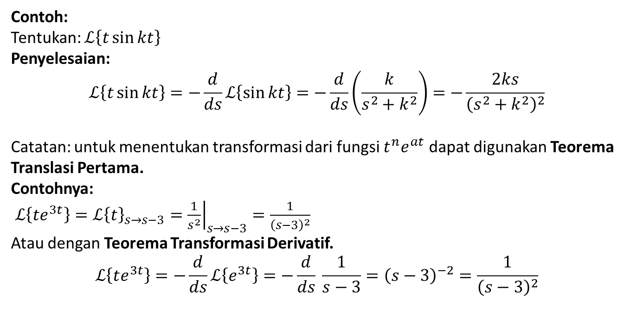
5
Perkalian Suatu Fungsi oleh $t^{n}$
Contoh:
Tentukan: $ℒ\left\{t\sin{kt}\right\}$
Penyelesaian:
$$ℒ\left\{t\sin{kt}\right\}=−\frac{d}{ds}ℒ\left\{\sin{kt}\right\}=−\frac{d}{ds}\left(\frac{k}{s^{2}+k^{2}}\right)=−\frac{2ks}{{\left(s^{2}+k^{2}\right)}^{2}}$$
Catatan: untuk menentukan transformasi dari fungsi $t^{n}e^{at}$ dapat digunakan Teorema Translasi Pertama.
Contohnya:
$ℒ\left\{te^{3t}\right\}={ℒ\left\{t\right\}}_{s→s−3}={\left.\frac{1}{s^{2}}\right|}_{s→s−3}=\frac{1}{{\left(s−3\right)}^{2}}$
Atau dengan Teorema Transformasi Derivatif.
$$ℒ\left\{te^{3t}\right\}=−\frac{d}{ds}ℒ\left\{e^{3t}\right\}=−\frac{d}{ds} \frac{1}{s−3}={\left(s−3\right)}^{−2}=\frac{1}{{\left(s−3\right)}^{2}}$$

Slide 16
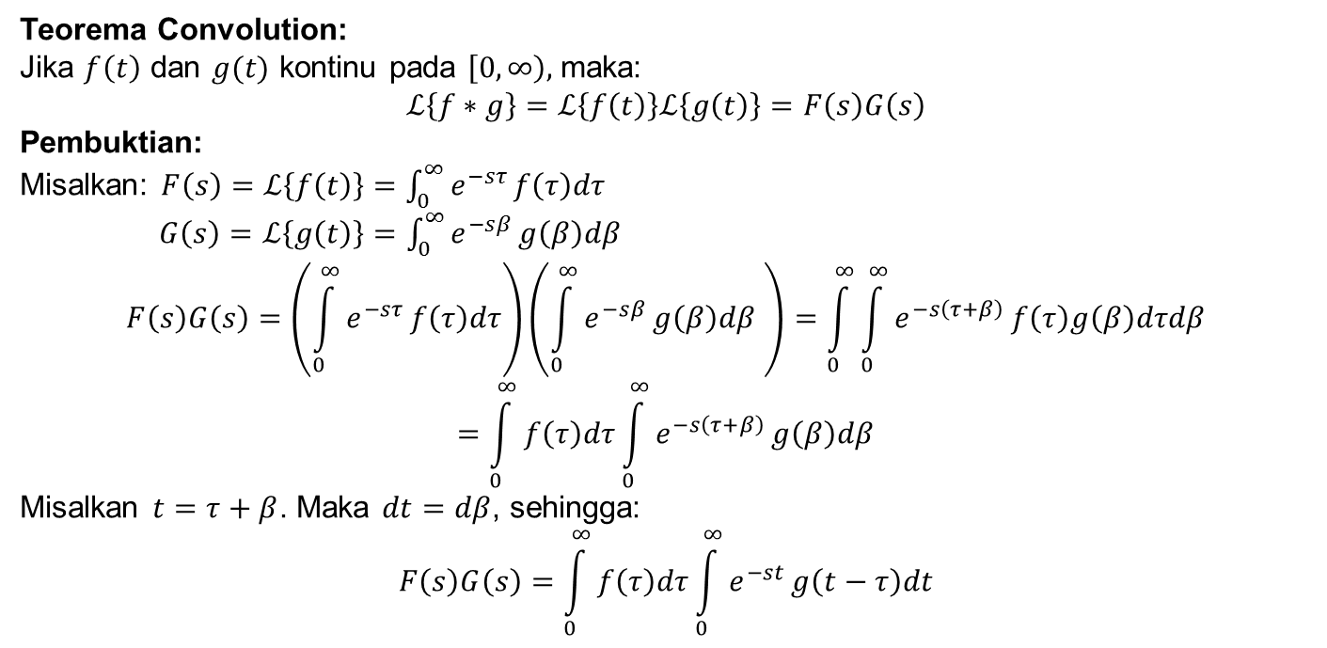
6
Transformasi Integral
Teorema Convolution:
Jika $f\left(t\right)$ dan $g(t)$ kontinu pada $\left[0, ∞\right),$maka:
$$ℒ\left\{f∗g\right\}=ℒ\left\{f\left(t\right)\right\}ℒ\left\{g\left(t\right)\right\}=F\left(s\right)G\left(s\right)$$
Pembuktian:
Misalkan: $F\left(s\right)=ℒ\left\{f\left(t\right)\right\}=\int_{0}^{∞}{e^{−sτ}}f\left(τ\right)dτ$
$G\left(s\right)=ℒ\left\{g\left(t\right)\right\}=\int_{0}^{∞}{e^{−sβ}}g\left(β\right)dβ$
$$F\left(s\right)G\left(s\right)=\left(\int_{0}^{∞}{e^{−sτ}}f\left(τ\right)dτ\right)\left(\int_{0}^{∞}{e^{−sβ}}g\left(β\right)dβ \right)=\int_{0}^{∞}{\int_{0}^{∞}{e^{−s\left(τ+β\right)}}f\left(τ\right)g\left(β\right)dτdβ}$$
$$=\int_{0}^{∞}{f\left(τ\right)dτ}\int_{0}^{∞}{e^{−s\left(τ+β\right)}}g\left(β\right)dβ$$
Misalkan $t=τ+β$. Maka $dt=dβ$, sehingga:
$$F\left(s\right)G\left(s\right)=\int_{0}^{∞}{f\left(τ\right)dτ}\int_{0}^{∞}{e^{−st}}g\left(t−τ\right)dt$$

Slide 17
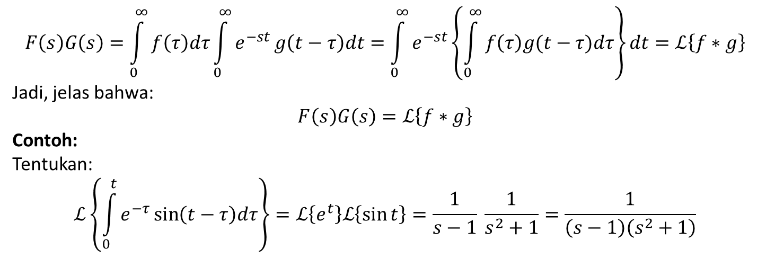
6
Transformasi Integral
$$F\left(s\right)G\left(s\right)=\int_{0}^{∞}{f\left(τ\right)dτ}\int_{0}^{∞}{e^{−st}}g\left(t−τ\right)dt=\int_{0}^{∞}{e^{−st}}\left\{\int_{0}^{∞}{f\left(τ\right)g(t−τ)dτ}\right\}dt=ℒ\left\{f∗g\right\}$$
Jadi, jelas bahwa:
$$F\left(s\right)G\left(s\right)=ℒ\left\{f∗g\right\}$$
Contoh:
Tentukan:
$$ℒ\left\{\int_{0}^{t}{e^{−τ}}\sin\left(t−τ\right)dτ\right\}=ℒ\left\{e^{t}\right\}ℒ\left\{\sin{t}\right\}=\frac{1}{s−1} \frac{1}{s^{2}+1}=\frac{1}{\left(s−1\right)\left(s^{2}+1\right)}$$

Slide 18
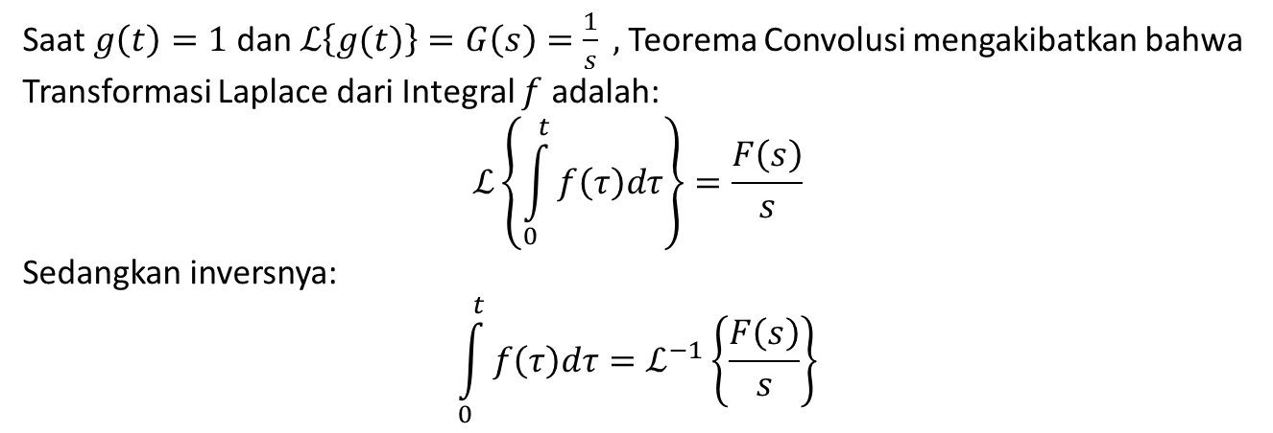
6
Transformasi Integral
Saat $g\left(t\right)=1$ dan $ℒ\left\{g(t)\right\}=G\left(s\right)=\frac{1}{s} ,$Teorema Convolusi mengakibatkan bahwa Transformasi Laplace dari Integral $f$ adalah:
$$ℒ\left\{\int_{0}^{t}{f\left(τ\right)dτ}\right\}=\frac{F\left(s\right)}{s}$$
Sedangkan inversnya:
$$\int_{0}^{t}{f\left(τ\right)dτ}=ℒ^{−1}\left\{\frac{F\left(s\right)}{s}\right\}$$

Slide 19
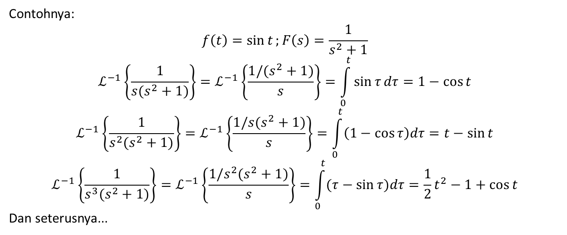
6
Transformasi Integral
Contohnya:
$$f\left(t\right)=\sin{t};F\left(s\right)=\frac{1}{s^{2}+1}$$
$$ℒ^{−1}\left\{\frac{1}{s(s^{2}+1)}\right\}=ℒ^{−1}\left\{\frac{1/(s^{2}+1)}{s}\right\}=\int_{0}^{t}{\sin{τ}dτ}=1−\cos{t}$$
$$ℒ^{−1}\left\{\frac{1}{s^{2}(s^{2}+1)}\right\}=ℒ^{−1}\left\{\frac{1/s(s^{2}+1)}{s}\right\}=\int_{0}^{t}{\left(1−\cos{τ}\right)dτ}=t−\sin{t}$$
$$ℒ^{−1}\left\{\frac{1}{s^{3}(s^{2}+1)}\right\}=ℒ^{−1}\left\{\frac{1/s^{2}(s^{2}+1)}{s}\right\}=\int_{0}^{t}{(τ−\sin{τ})dτ}=\frac{1}{2}t^{2}−1+\cos{t}$$
Dan seterusnya...

Slide 20
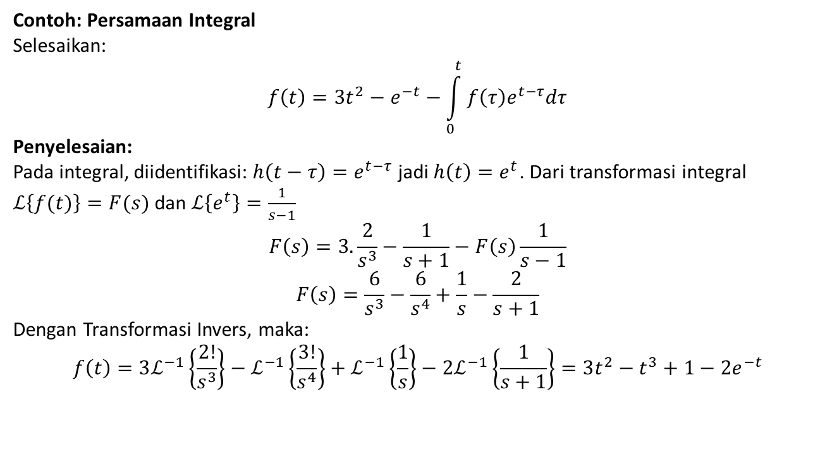
6
Transformasi Integral
Contoh: Persamaan Integral
Selesaikan:
$$f\left(t\right)=3t^{2}−e^{−t}−\int_{0}^{t}{f\left(τ\right)e^{t−τ}dτ}$$
Penyelesaian:
Pada integral, diidentifikasi: $h\left(t−τ\right)=e^{t−τ}$ jadi $h\left(t\right)=e^{t}$. Dari transformasi integral
$ℒ\left\{f(t)\right\}=F(s)$ dan $ℒ\left\{e^{t}\right\}=\frac{1}{s−1}$
$$F\left(s\right)=3.\frac{2}{s^{3}}−\frac{1}{s+1}−F\left(s\right)\frac{1}{s−1}$$
$$F\left(s\right)=\frac{6}{s^{3}}−\frac{6}{s^{4}}+\frac{1}{s}−\frac{2}{s+1}$$
Dengan Transformasi Invers, maka:
$$f\left(t\right)=3ℒ^{−1}\left\{\frac{2!}{s^{3}}\right\}−ℒ^{−1}\left\{\frac{3!}{s^{4}}\right\}+ℒ^{−1}\left\{\frac{1}{s}\right\}−2ℒ^{−1}\left\{\frac{1}{s+1}\right\}=3t^{2}−t^{3}+1−2e^{−t}$$

Slide 21
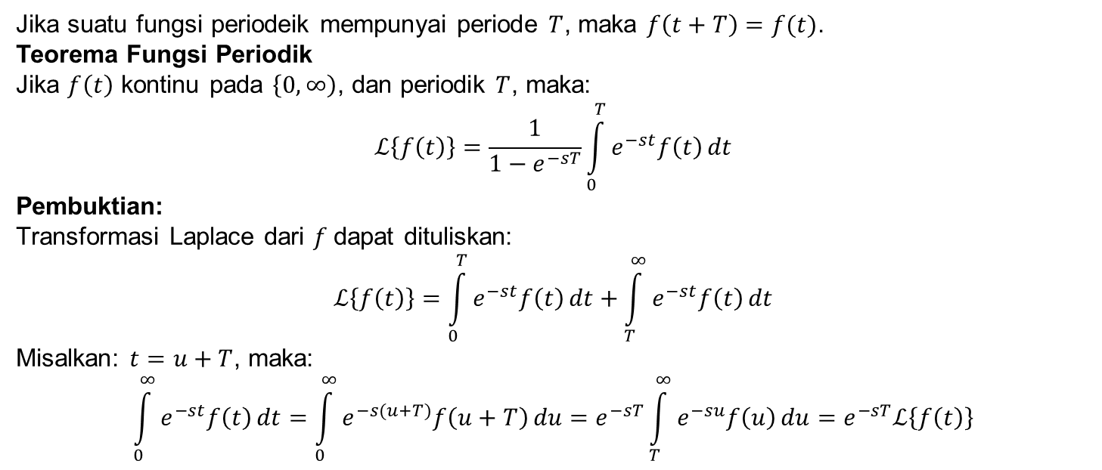
7
Transformasi dari Fungsi Periodik
Jika suatu fungsi periodeik mempunyai periode $T$, maka $f\left(t+T\right)=f(t)$.
Teorema Fungsi Periodik
Jika $f\left(t\right)$ kontinu pada $\left\{0, ∞\right)$, dan periodik $T$, maka:
$$ℒ\left\{f\left(t\right)\right\}=\frac{1}{1−e^{−sT}}\int_{0}^{T}{e^{−st}f\left(t\right)}dt$$
Pembuktian:
Transformasi Laplace dari $f$dapat dituliskan:
$$ℒ\left\{f\left(t\right)\right\}=\int_{0}^{T}{e^{−st}f\left(t\right)}dt+\int_{T}^{∞}{e^{−st}f\left(t\right)}dt$$
Misalkan: $t=u+T$, maka:
$$\int_{0}^{∞}{e^{−st}f\left(t\right)}dt=\int_{0}^{∞}{e^{−s(u+T)}f\left(u+T\right)}du=e^{−sT}\int_{T}^{∞}{e^{−su}f\left(u\right)}du=e^{−sT}ℒ\left\{f\left(t\right)\right\}$$

Slide 22
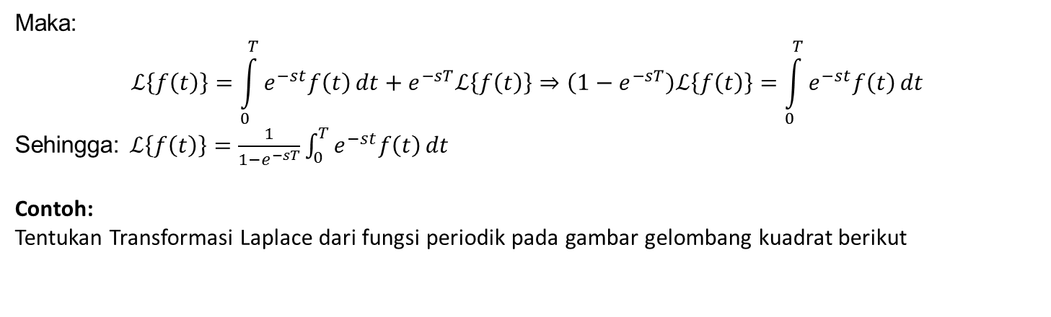
7
Transformasi dari Fungsi Periodik
Maka:
$$ℒ\left\{f\left(t\right)\right\}=\int_{0}^{T}{e^{−st}f\left(t\right)}dt+e^{−sT}ℒ\left\{f\left(t\right)\right\}⇒\left(1−e^{−sT}\right)ℒ\left\{f\left(t\right)\right\}=\int_{0}^{T}{e^{−st}f\left(t\right)}dt$$
Sehingga: $ℒ\left\{f\left(t\right)\right\}=\frac{1}{1−e^{−sT}}\int_{0}^{T}{e^{−st}f\left(t\right)}dt$
Contoh:
Tentukan Transformasi Laplace dari fungsi periodik pada gambar gelombang kuadrat berikut

Slide 23
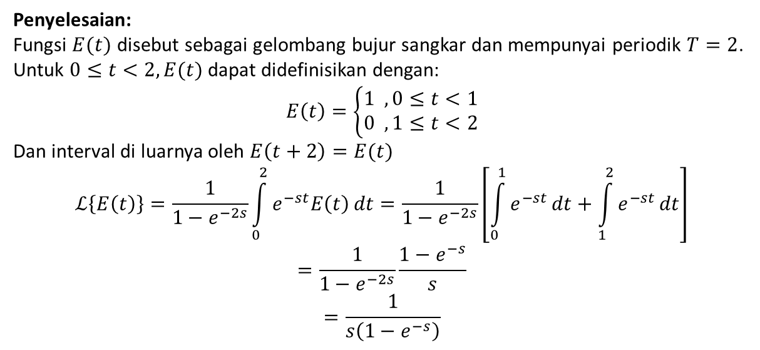
7
Transformasi dari Fungsi Periodik
Penyelesaian:
Fungsi $E(t)$ disebut sebagai gelombang bujur sangkar dan mempunyai periodik $T=2$.
Untuk $0≤t<2, E(t)$ dapat didefinisikan dengan:
$$E\left(t\right)=\left\{\begin{aligned}1 , 0≤t<1 \\ 0 , 1≤t<2\end{aligned}\right.$$
Dan interval di luarnya oleh $E\left(t+2\right)=E(t)$
$$ℒ\left\{E\left(t\right)\right\}=\frac{1}{1−e^{−2s}}\int_{0}^{2}{e^{−st}E\left(t\right)}dt=\frac{1}{1−e^{−2s}}\left[\int_{0}^{1}{e^{−st}}dt+\int_{1}^{2}{e^{−st}}dt\right]$$
$$=\frac{1}{1−e^{−2s}}\frac{1−e^{−s}}{s}$$
$$=\frac{1}{s\left(1−e^{−s}\right)}$$

Slide 24
Thank you

